Slide 1
PROJECT -1
Title – Facebook DATA ANALYSIS USING HDFS AND HIVE.
DEVELOPED BY:-
OMKAR SATISH GAIKWAD

Slide 2
DESCRIPTION :-
FACEBOOK DATASET FROM KAGGLE.
DATASET CONTAINS 15 COLUMNS AND 99003 ROWS.
USING HORTONWORKS SANDBOX AND AMBARI IMPORT THE DATASET TO HDFS.
CREATED THE TABLE IN HIVE BY GIVE LOCATION OF IMPORTED TABLE IN HDFS.
NEXT STEP WAS TO WRITE QUERY FOR ANALYSIS.

Slide 3
Problem statement:- We have the dataset of Facebook. We need to find some
insights on it. For Business growth and to improve marketing strategy. Finding the
right target audience .
Find out the total number of user in this datasets;
Find out the count of Facebook user for each birthday month
Do young member use mobile phone or computer for Facebook browsing?
Do young member use mobile phone or computer for Facebook browsing?

Slide 4
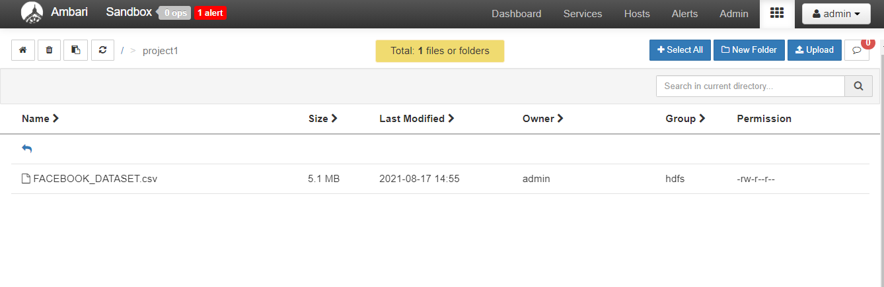
USING AMBARI UPLOAD THE FILE INT0 HDFS

Slide 5
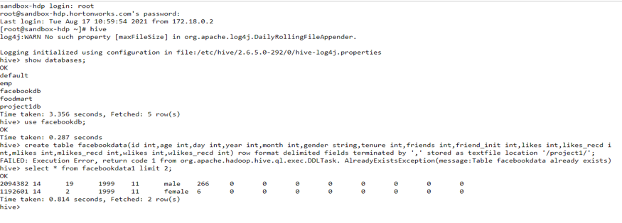
CREATING DATABASE IN HIVE
CREATE DATABASE facebookdb;
Use facebookdb;
create table facebookdata1(id int,age int,day int,year int,month int,gender string,tenure int,friends int,friend_init int,likes int,likes_recd int,mlikes int,mlikes_recd int,wlikes int,wlikes_recd int) row format delimited fields terminated by ',' stored as textfile location '/project1/';

Slide 6
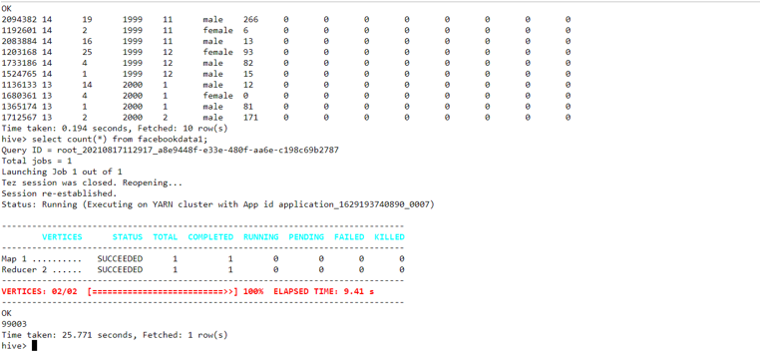
Find out the total number of user in this datasets
select count(*) from facebookdata1;

Slide 7
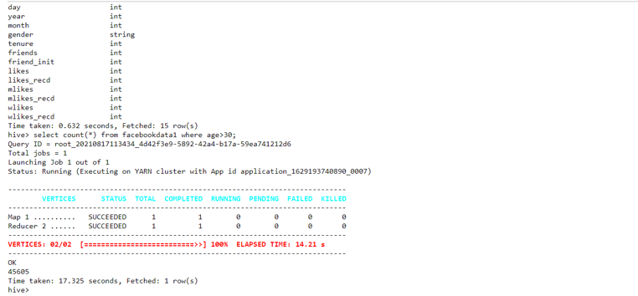
Find out the number of Facebook user above age of 30
select count(*) from facebookdata1 where age>30;

Slide 8
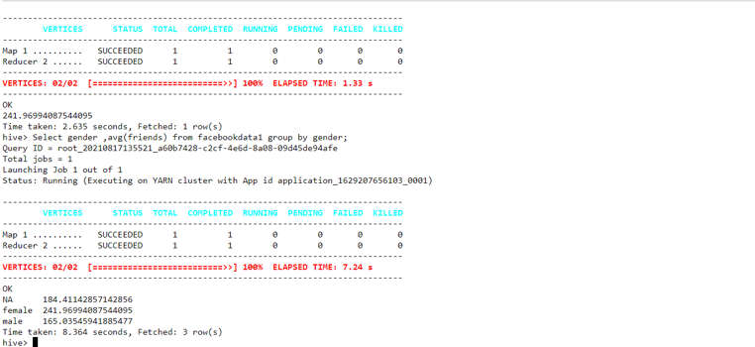
Do male facebook user tend to have more friend or female user?
select avg(friends) from facebookdata1 where gender=’male’;
select avg(friends) from facebookdata1 where gender=’female’;
By using this two we will get individual output
Select gender ,avg(friends) from facebookdata1 group by gender;

Slide 9
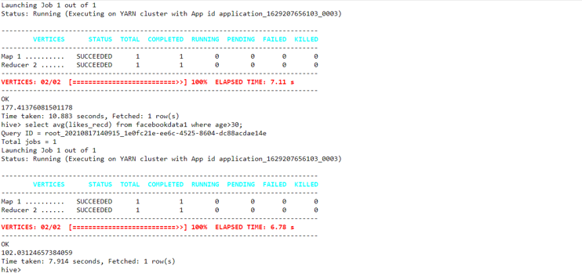
How many like do young people receive on facebook opposed to older member?
select avg(likes_recd) from facebookdata1 where age between '13' and '30’;
select avg(likes_recd) from facebookdata1 where age>30;

Slide 10
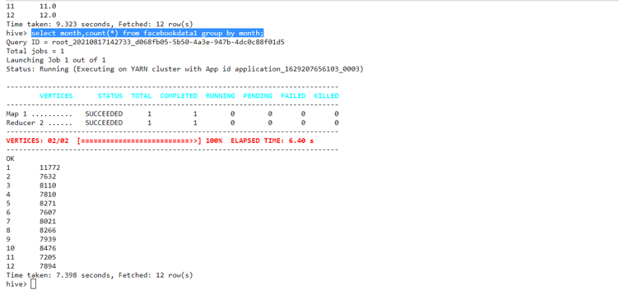
Find out the count of facebook user for each birthday month
select month,count(*) from facebookdata1 group by month;

Slide 11
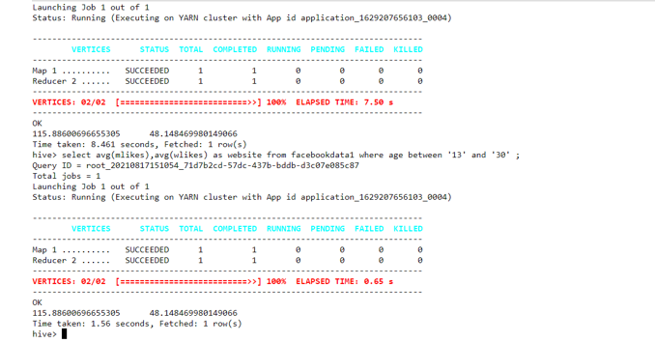
Do young member use mobile phone or computer for facebook browsing?
select avg(mlikes),avg(wlikes) as website from facebookdata1 where age between '13' and '30' ;

Slide 12
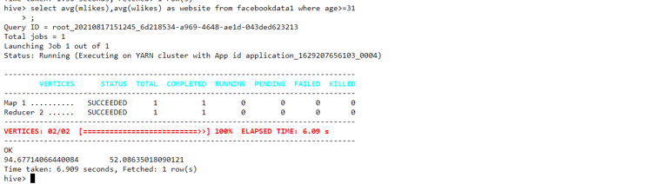
Do adult member use mobile phone or computer for Facebook browsing?
select avg(mlikes),avg(wlikes) as website from facebookdata1 where age>=31;

Slide 13
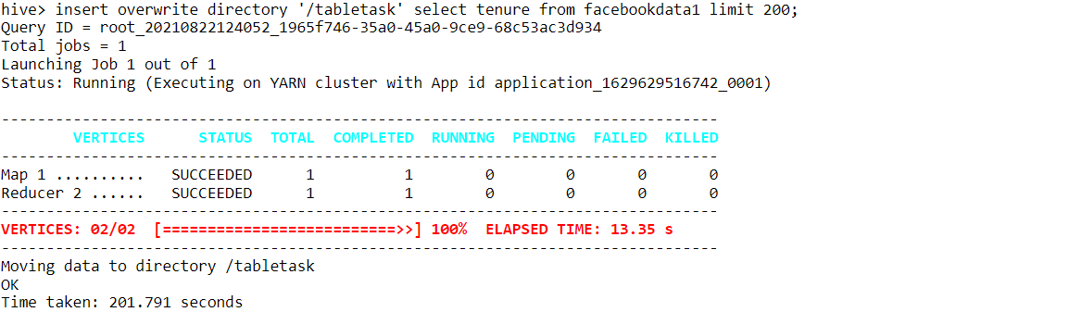
insert overwrite directory '/tabletask' select tenure from facebookdata1 limit 200;

Slide 14
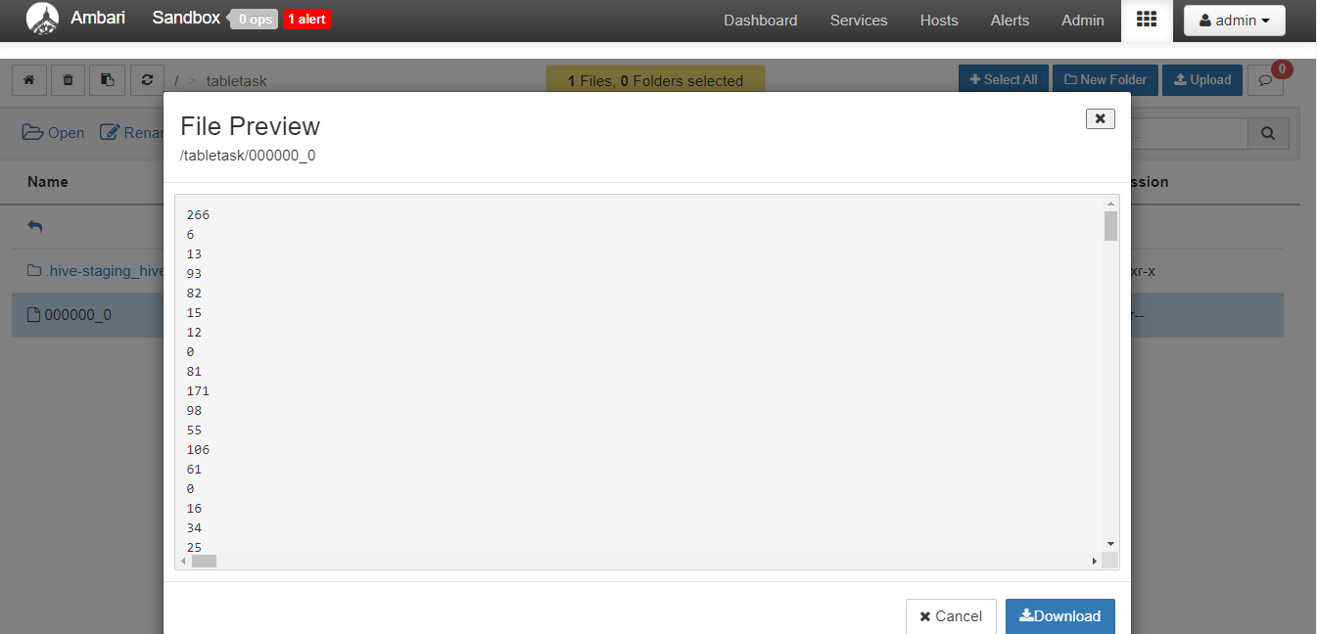

Slide 15
Partition
create table facebookdata4(id int,age int,day int,gender string,tenure int,friends int,friend_init int,likes int,likes_recd int,mlikes int,mlikes_recd int,wlikes int,wlikes_recd int) partitioned by (year int,month int);
insert overwrite table facebookdata4 partition(year,month) select id,age,day,gender,tenure,friends,friend_ini,likes,likes_recd,mlikes,mlikes_re cd,wlikes,wlikes_recd,year,month from facebookdata1;

Slide 16
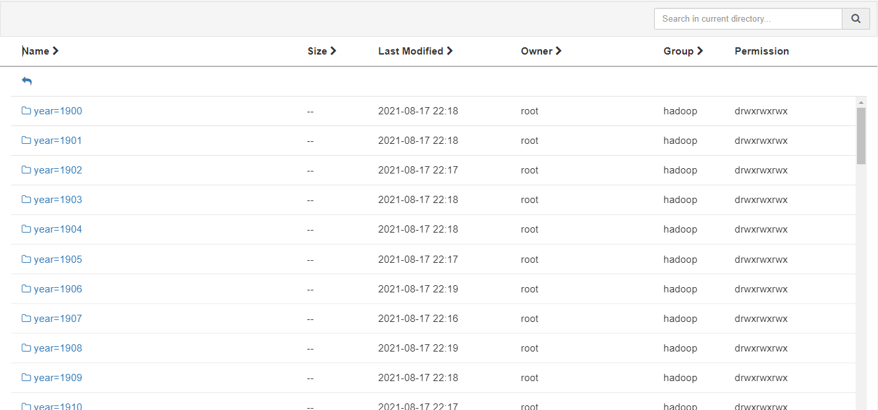

Slide 17
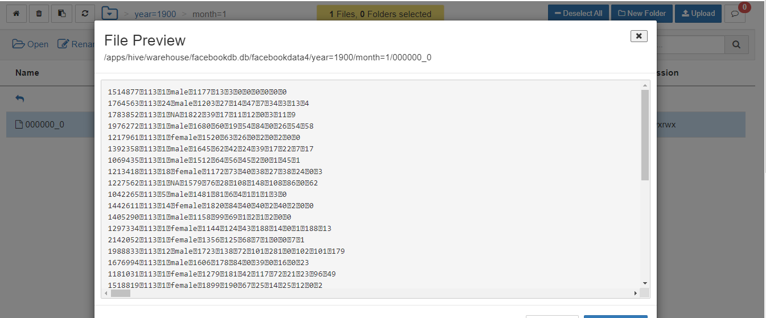

Slide 18
THANK YOU

